Slide 1
MGH MouseShare Resource
MGH Continuous Research Operations Improvement (CROI)
Animal Care and Use Working Group
Jim Moon, Donna Jarrell, Anne Clancy
MGH Executive Committee on Research (ECOR)
MGH Center for Systems Biology
Misha Pivovarov

Slide 2
Problem: Need for coordinated sharing of mouse strains at MGH
CROI eSuggestions:
RES #127 Request Summary: post a list mouse strains used at MGH for sharing with other PI's Received: Thu Nov 15 16:33:31 2012
RES #543 Request Summary: PI has requested a mouse models database be developed. Received: Fri Nov 28 19:06:21 2014
Acquiring mouse strains is often slow and expensive
shipping ($30 - $500)
health reports (few weeks)
quarantine (6 weeks, ~$300)
rederivation (2 months, $2500-$3000)
embryo cryorecovery (2 months, ~$2500)
institution importation bans
Poor communication within the large MGH research community
more than 6000 research staff
many incidences of people purchasing/importing mice already present at MGH

Slide 3
Solution: Mouse strain database (resource) to facilitate sharing among MGH investigators
Advantages:
comprehensive
quick results
no email spam
personalized, private requests between investigators
Disadvantages:
requires data entry
requires periodic updating
difficulty of searches based on strain names
may require knowledgeable staff effort to oversee database

Slide 4
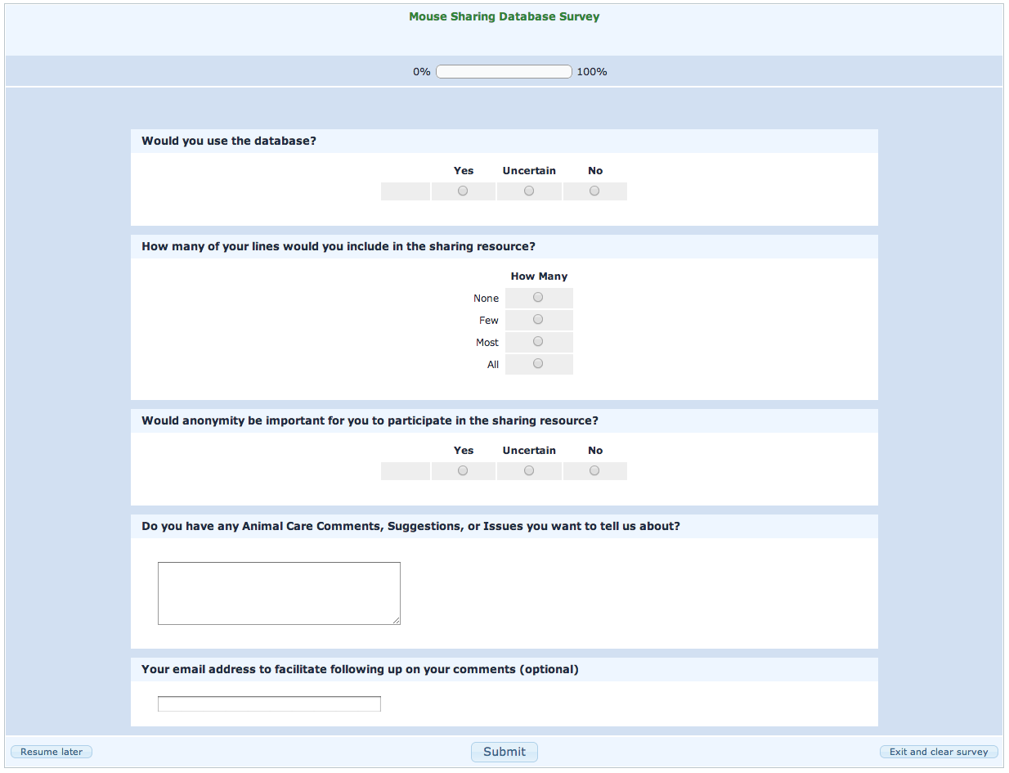
93 responses
82
11
0
11
18
35
25
17
24
52

Slide 5
This database is urgently needed at MGH in order to economize mouse purchasing holding for investigators.
Some of the strain cannot be shared unless there is a permission from the developer, this database has to overcome that.
I hope that researchers will see this as an opportunity to set up collaborations, no just as a way to save time and money on buying mice.
Thank you for the great initiative. We have 80+ lines and would be happy to share if the condition allows us to do so...
Great idea. I suggest extending it to genetic rats as well.
It would be wonderful to develop also a resource to exchange knowledge about effective breeding programs for mice.
I think this is a great idea and I keep telling this to everybody, so finally somebody heard my voice. Thanks a lot! ...

Slide 6
Desired features of sharing resource
Comprehensiveness
mouse strains from commercial vendors, public repositories, academic labs
updated periodically
Ease of use
web-based application
simple, intuitive interface
Privacy
access only through Partners secure login
investigator identities revealed to each other only after request is made
Limited scope
resource only matches seeker with provider
legal issues (MTAs) to be coordinated by seeker and provider
transfer issues to be coordinated by seeker and provider

Slide 7
MGH BioShare Resource
Mice
Antibodies
Other Animals
Cell Lines
Plasmids

Slide 8
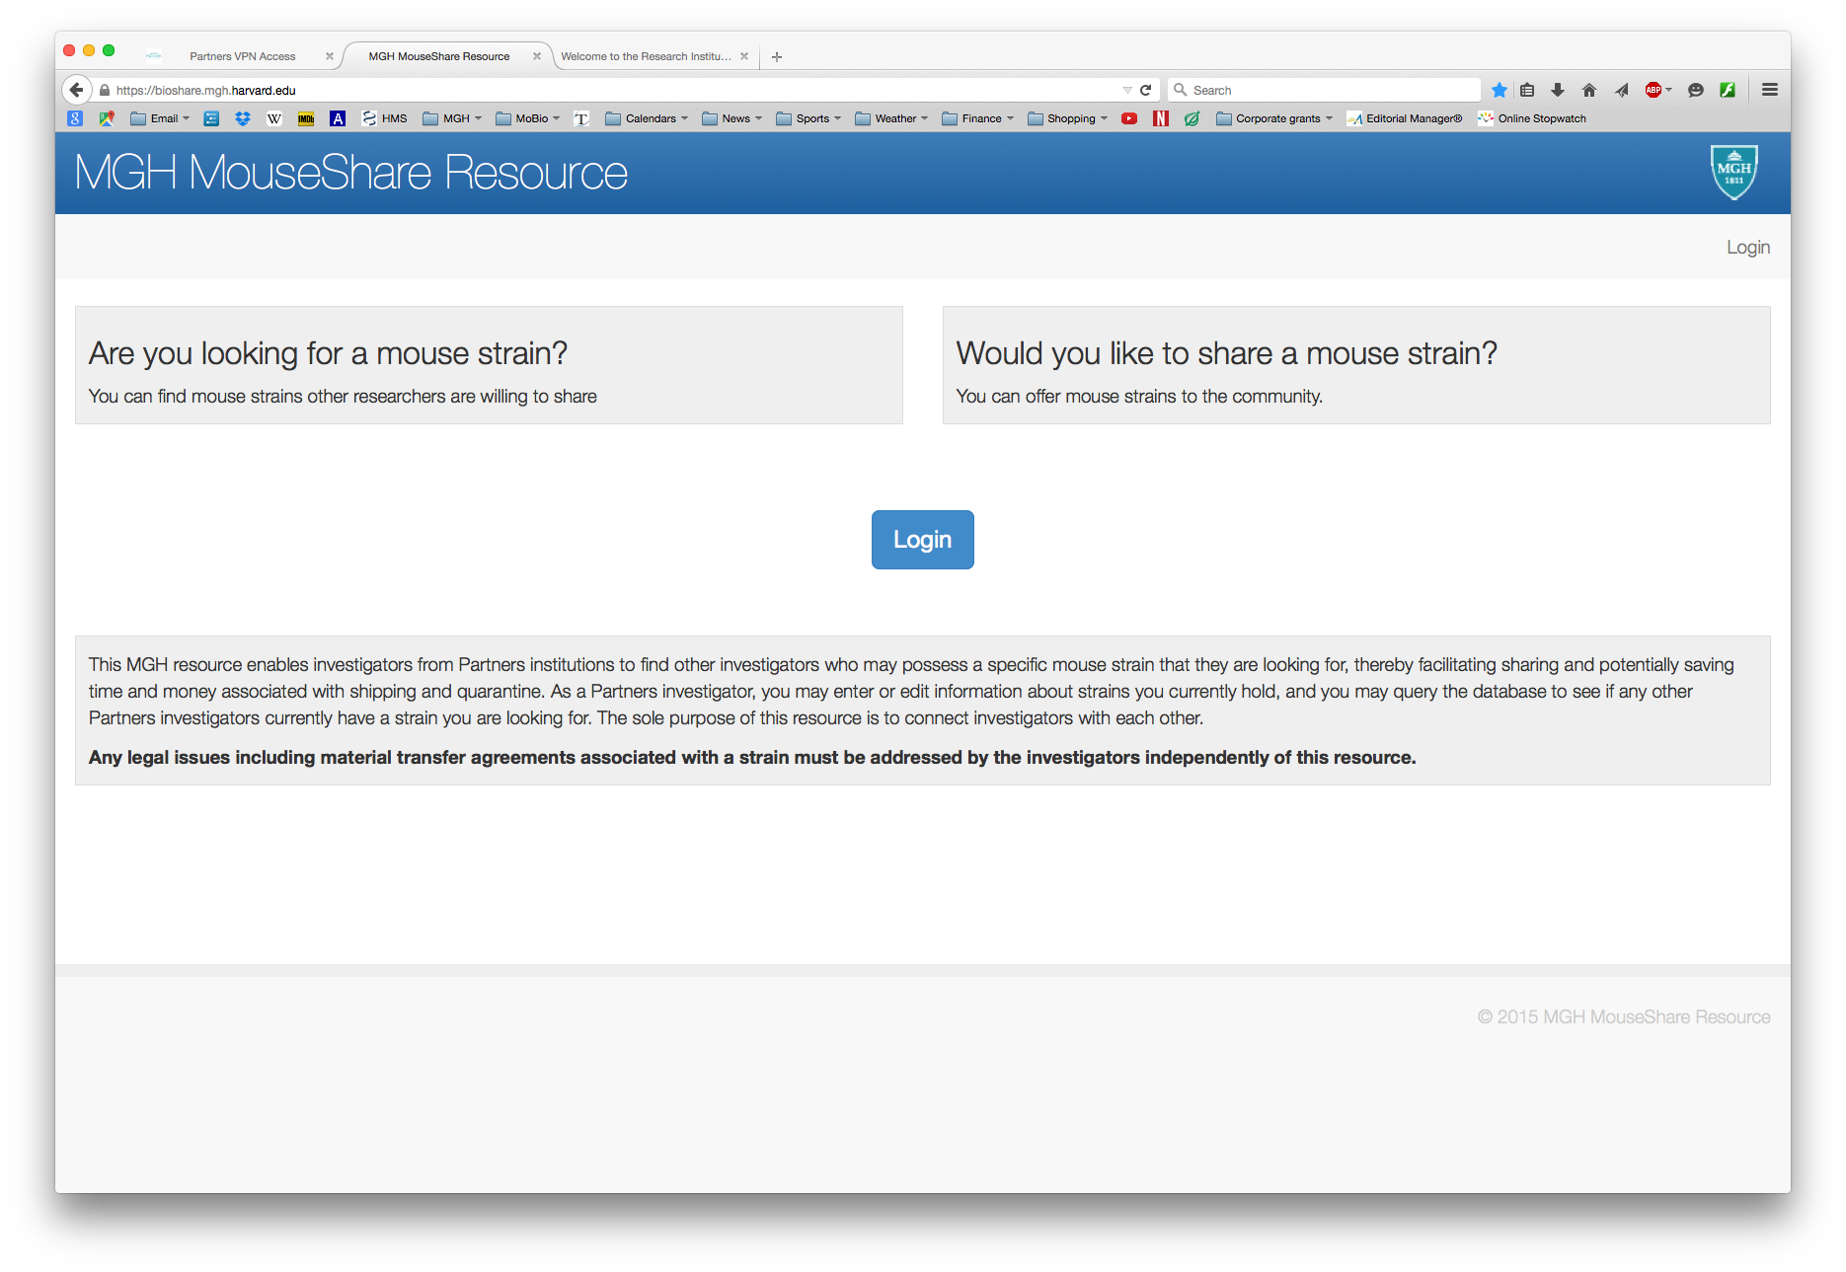

Slide 9
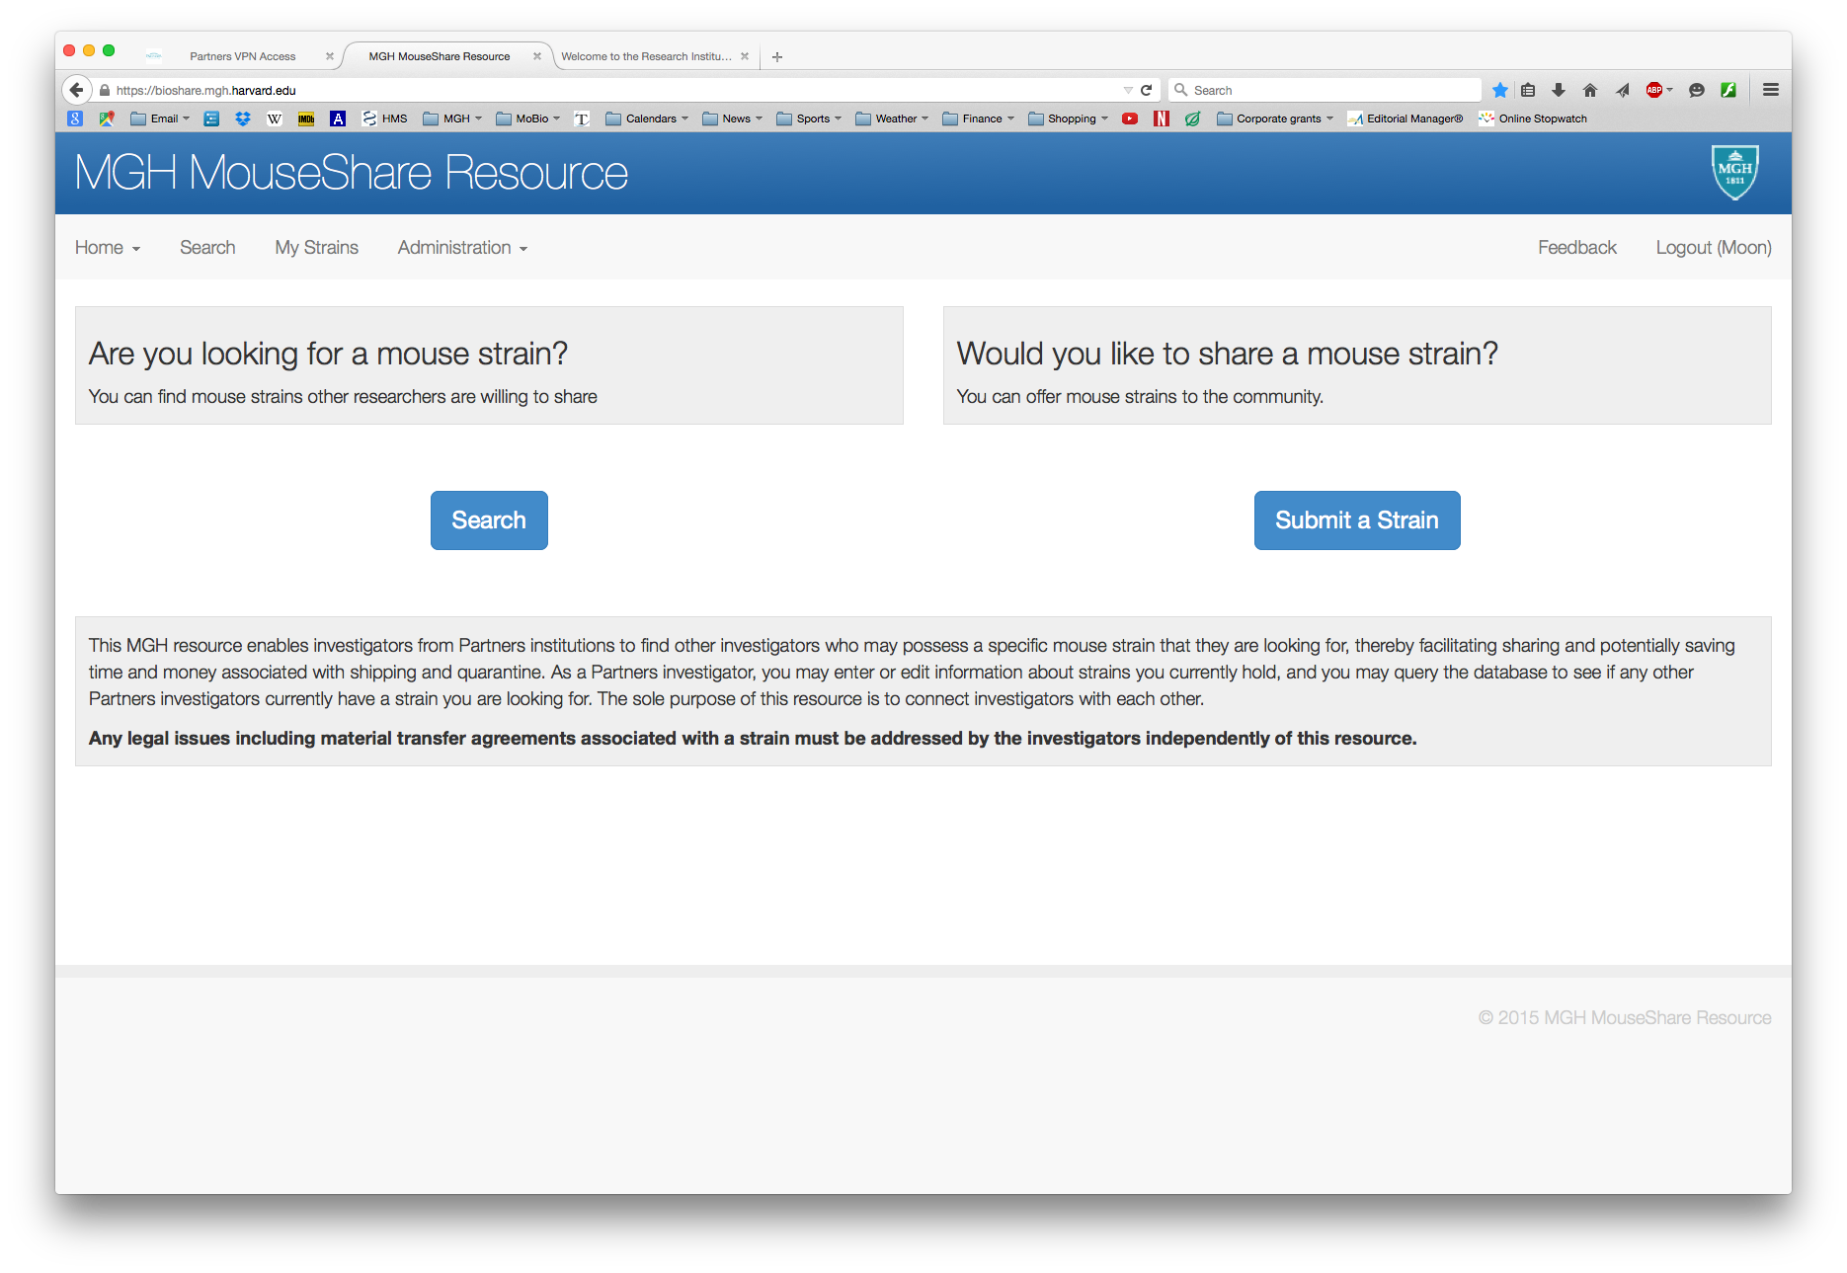

Slide 10
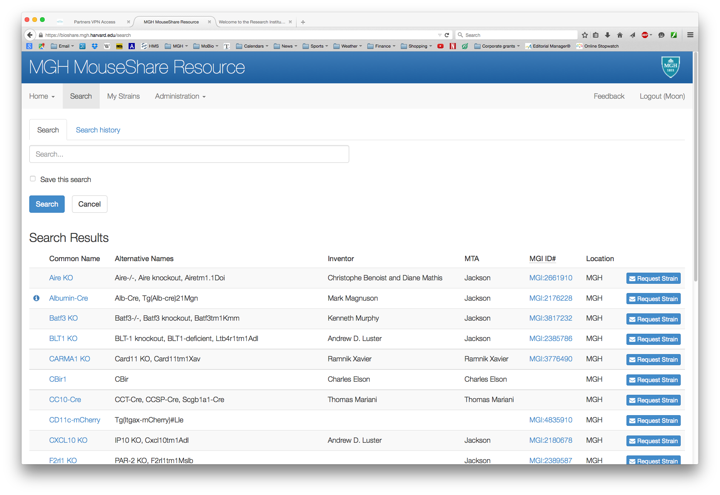

Slide 11
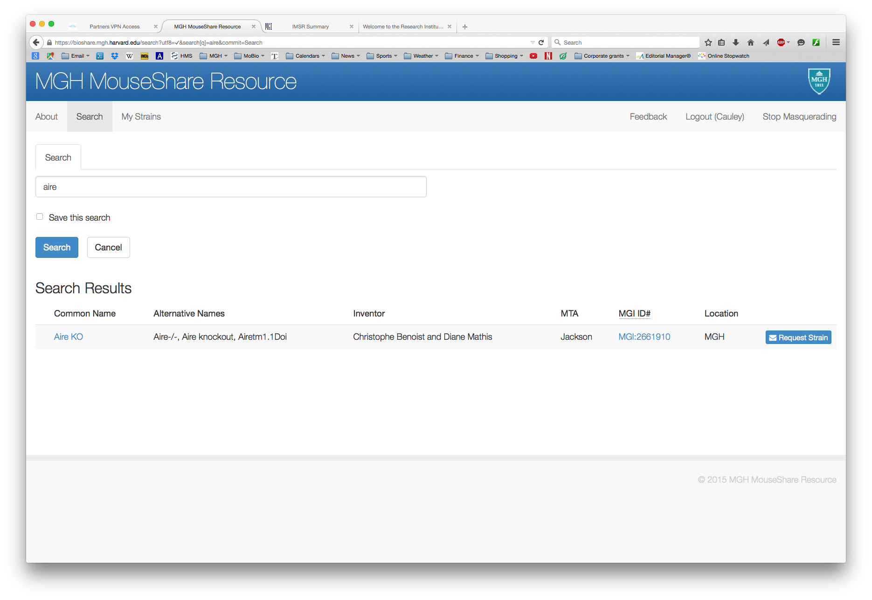

Slide 12
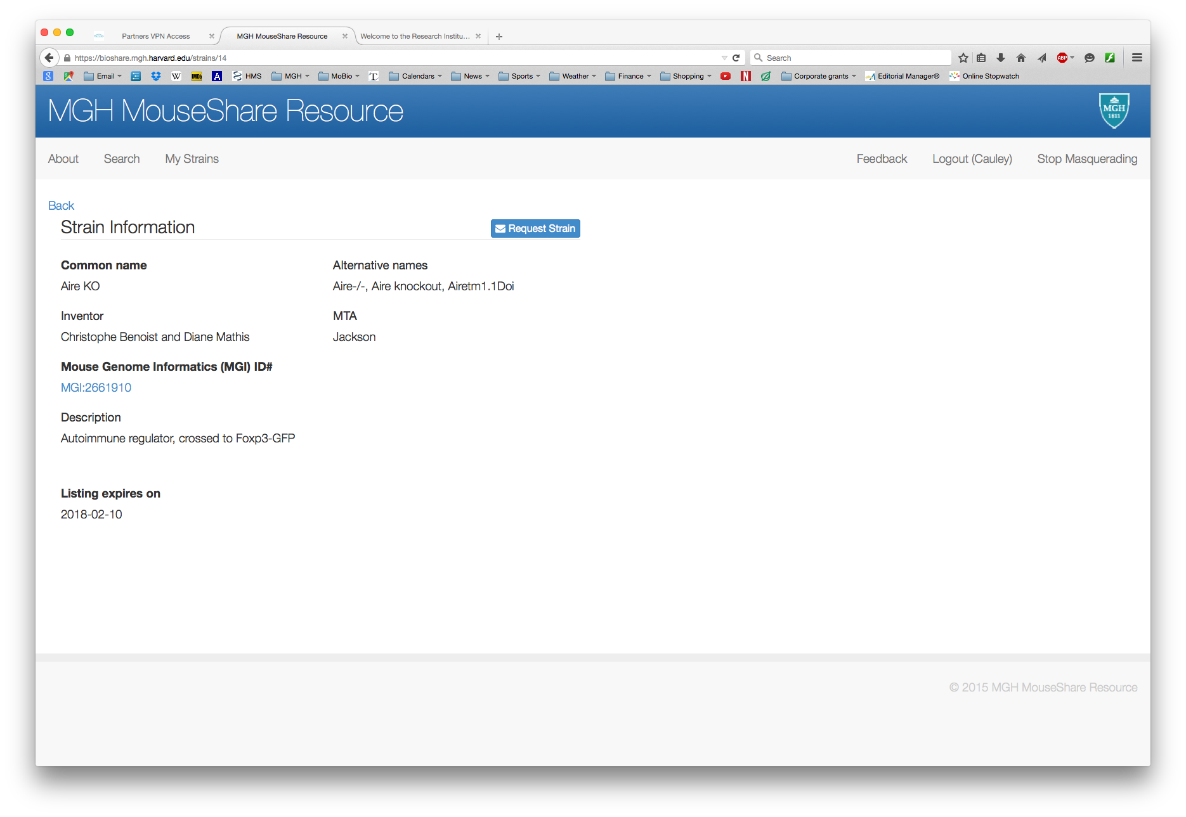

Slide 13
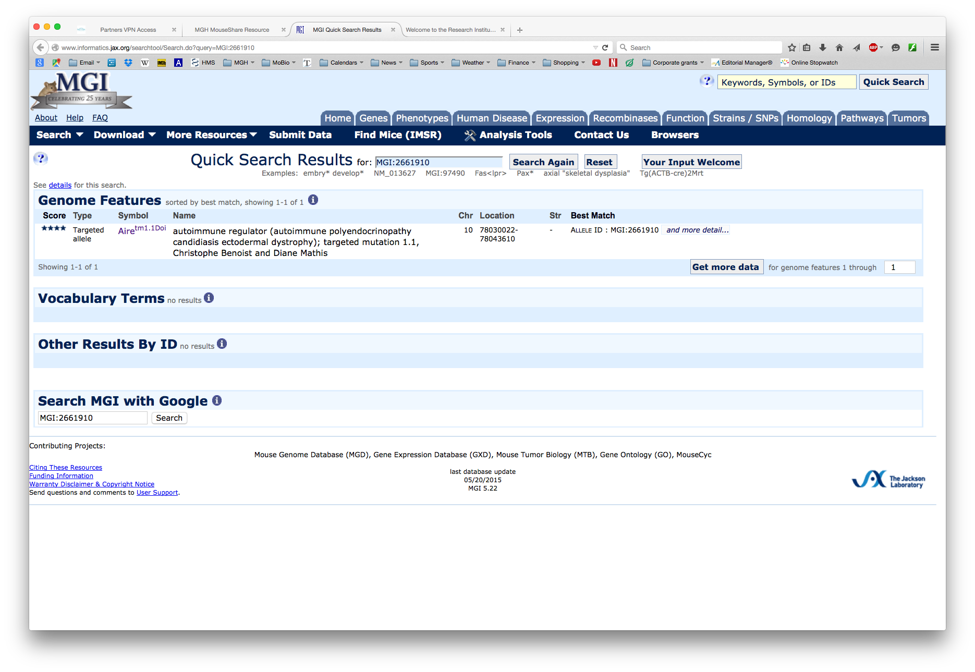

Slide 14
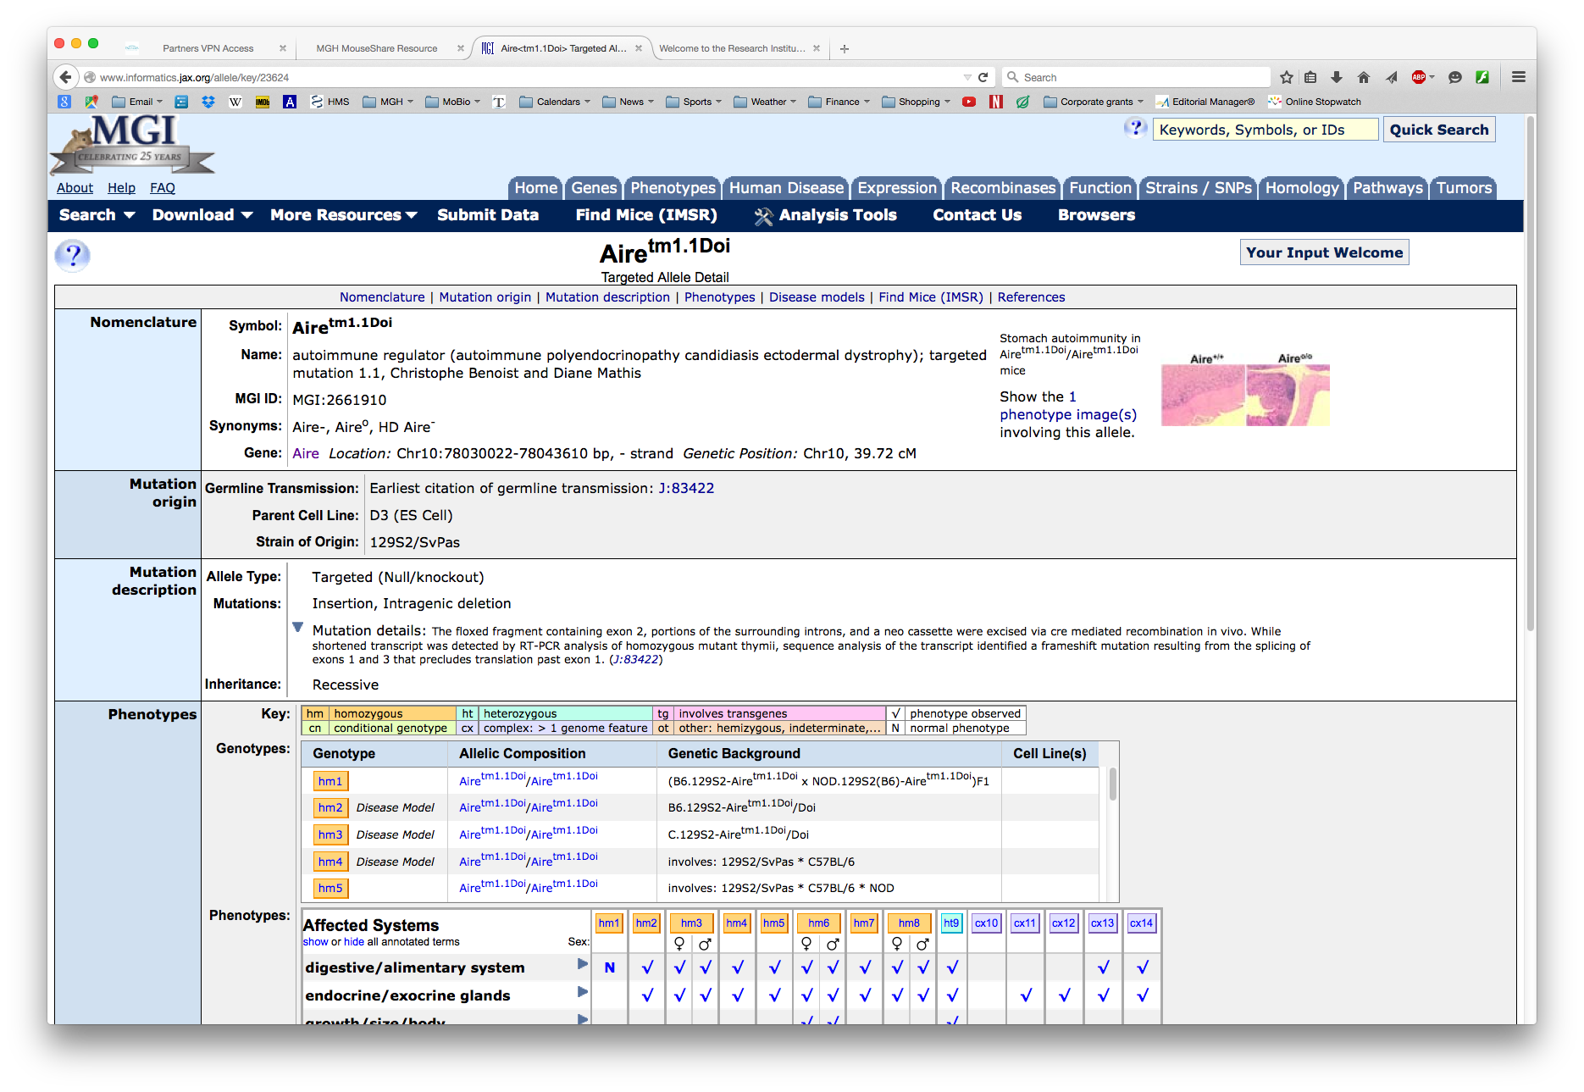

Slide 15
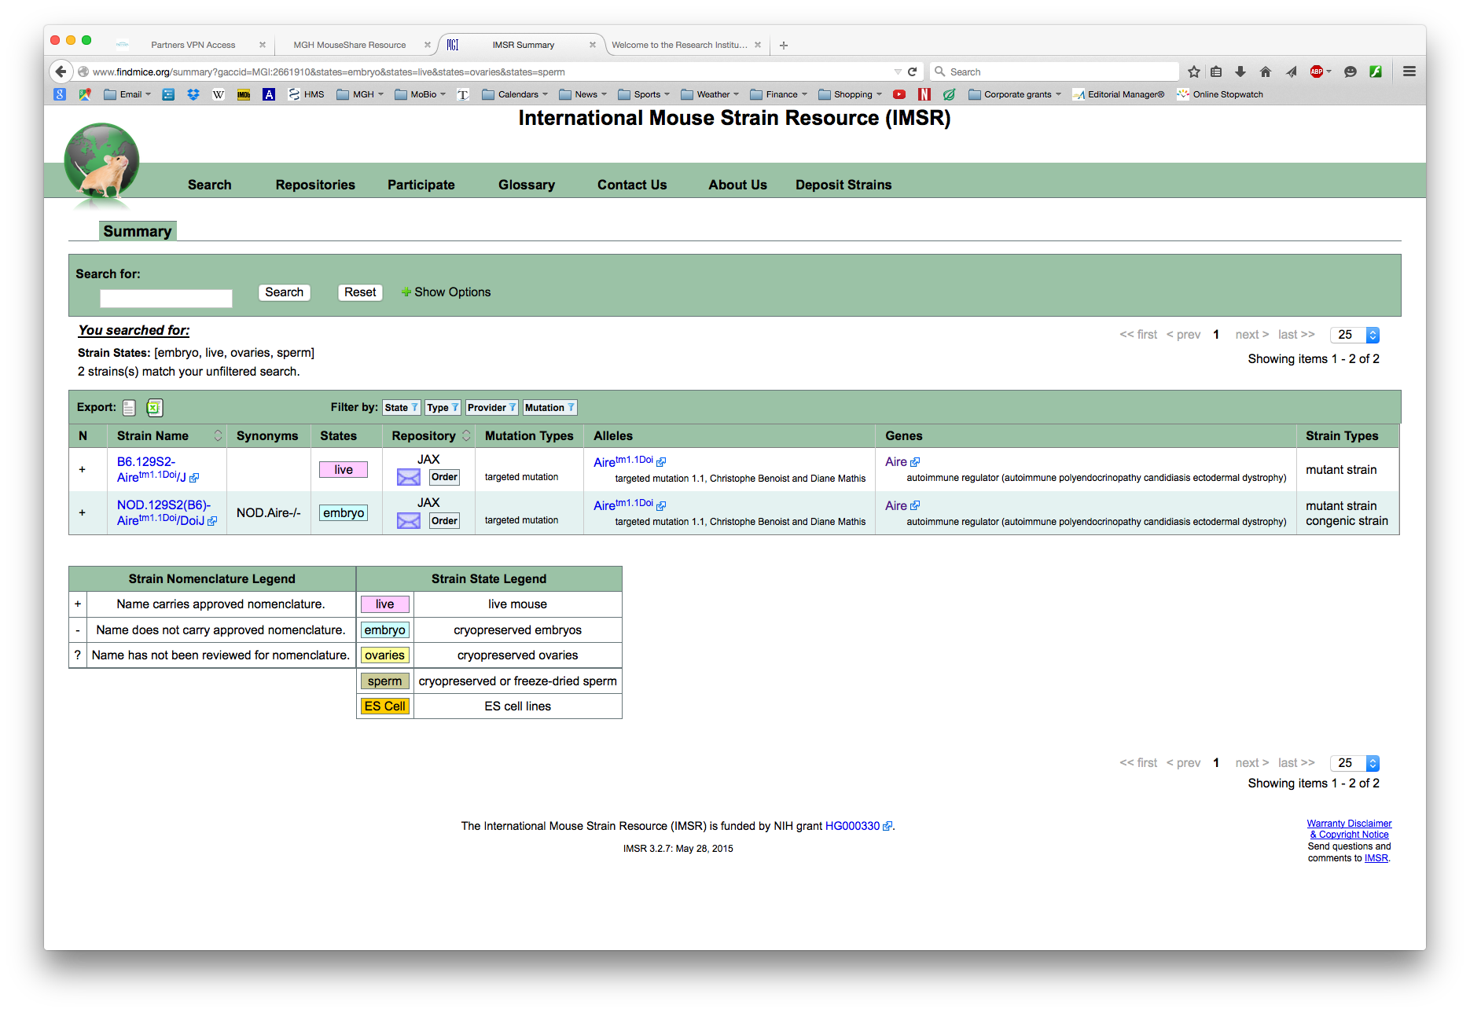

Slide 17
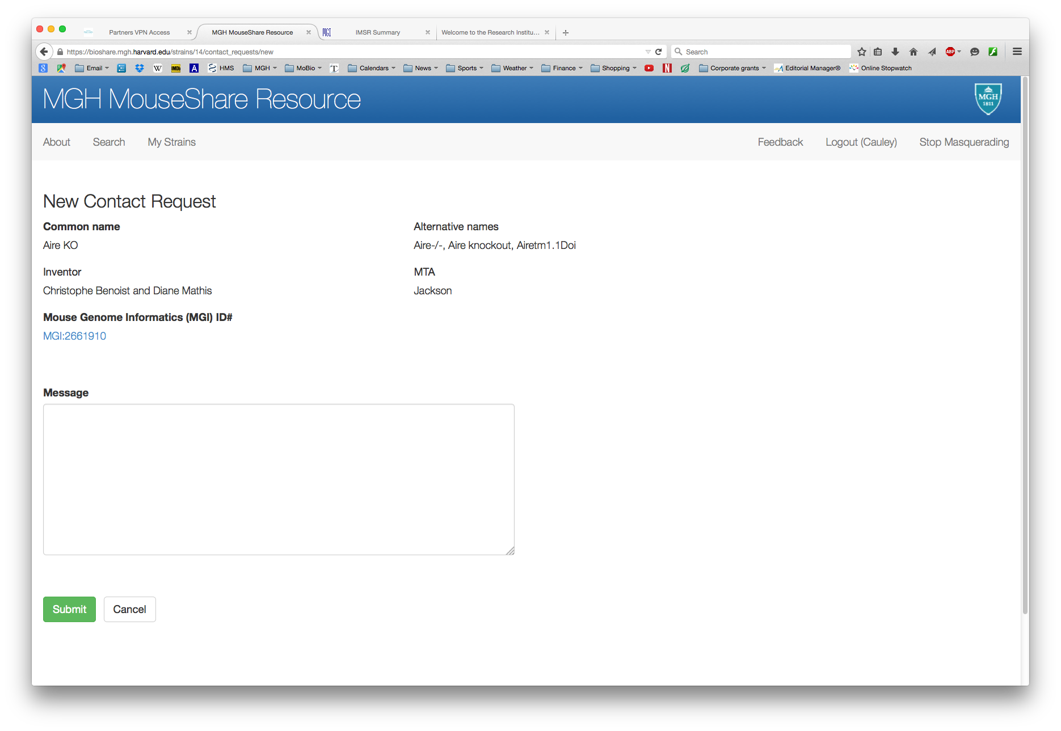

Slide 18
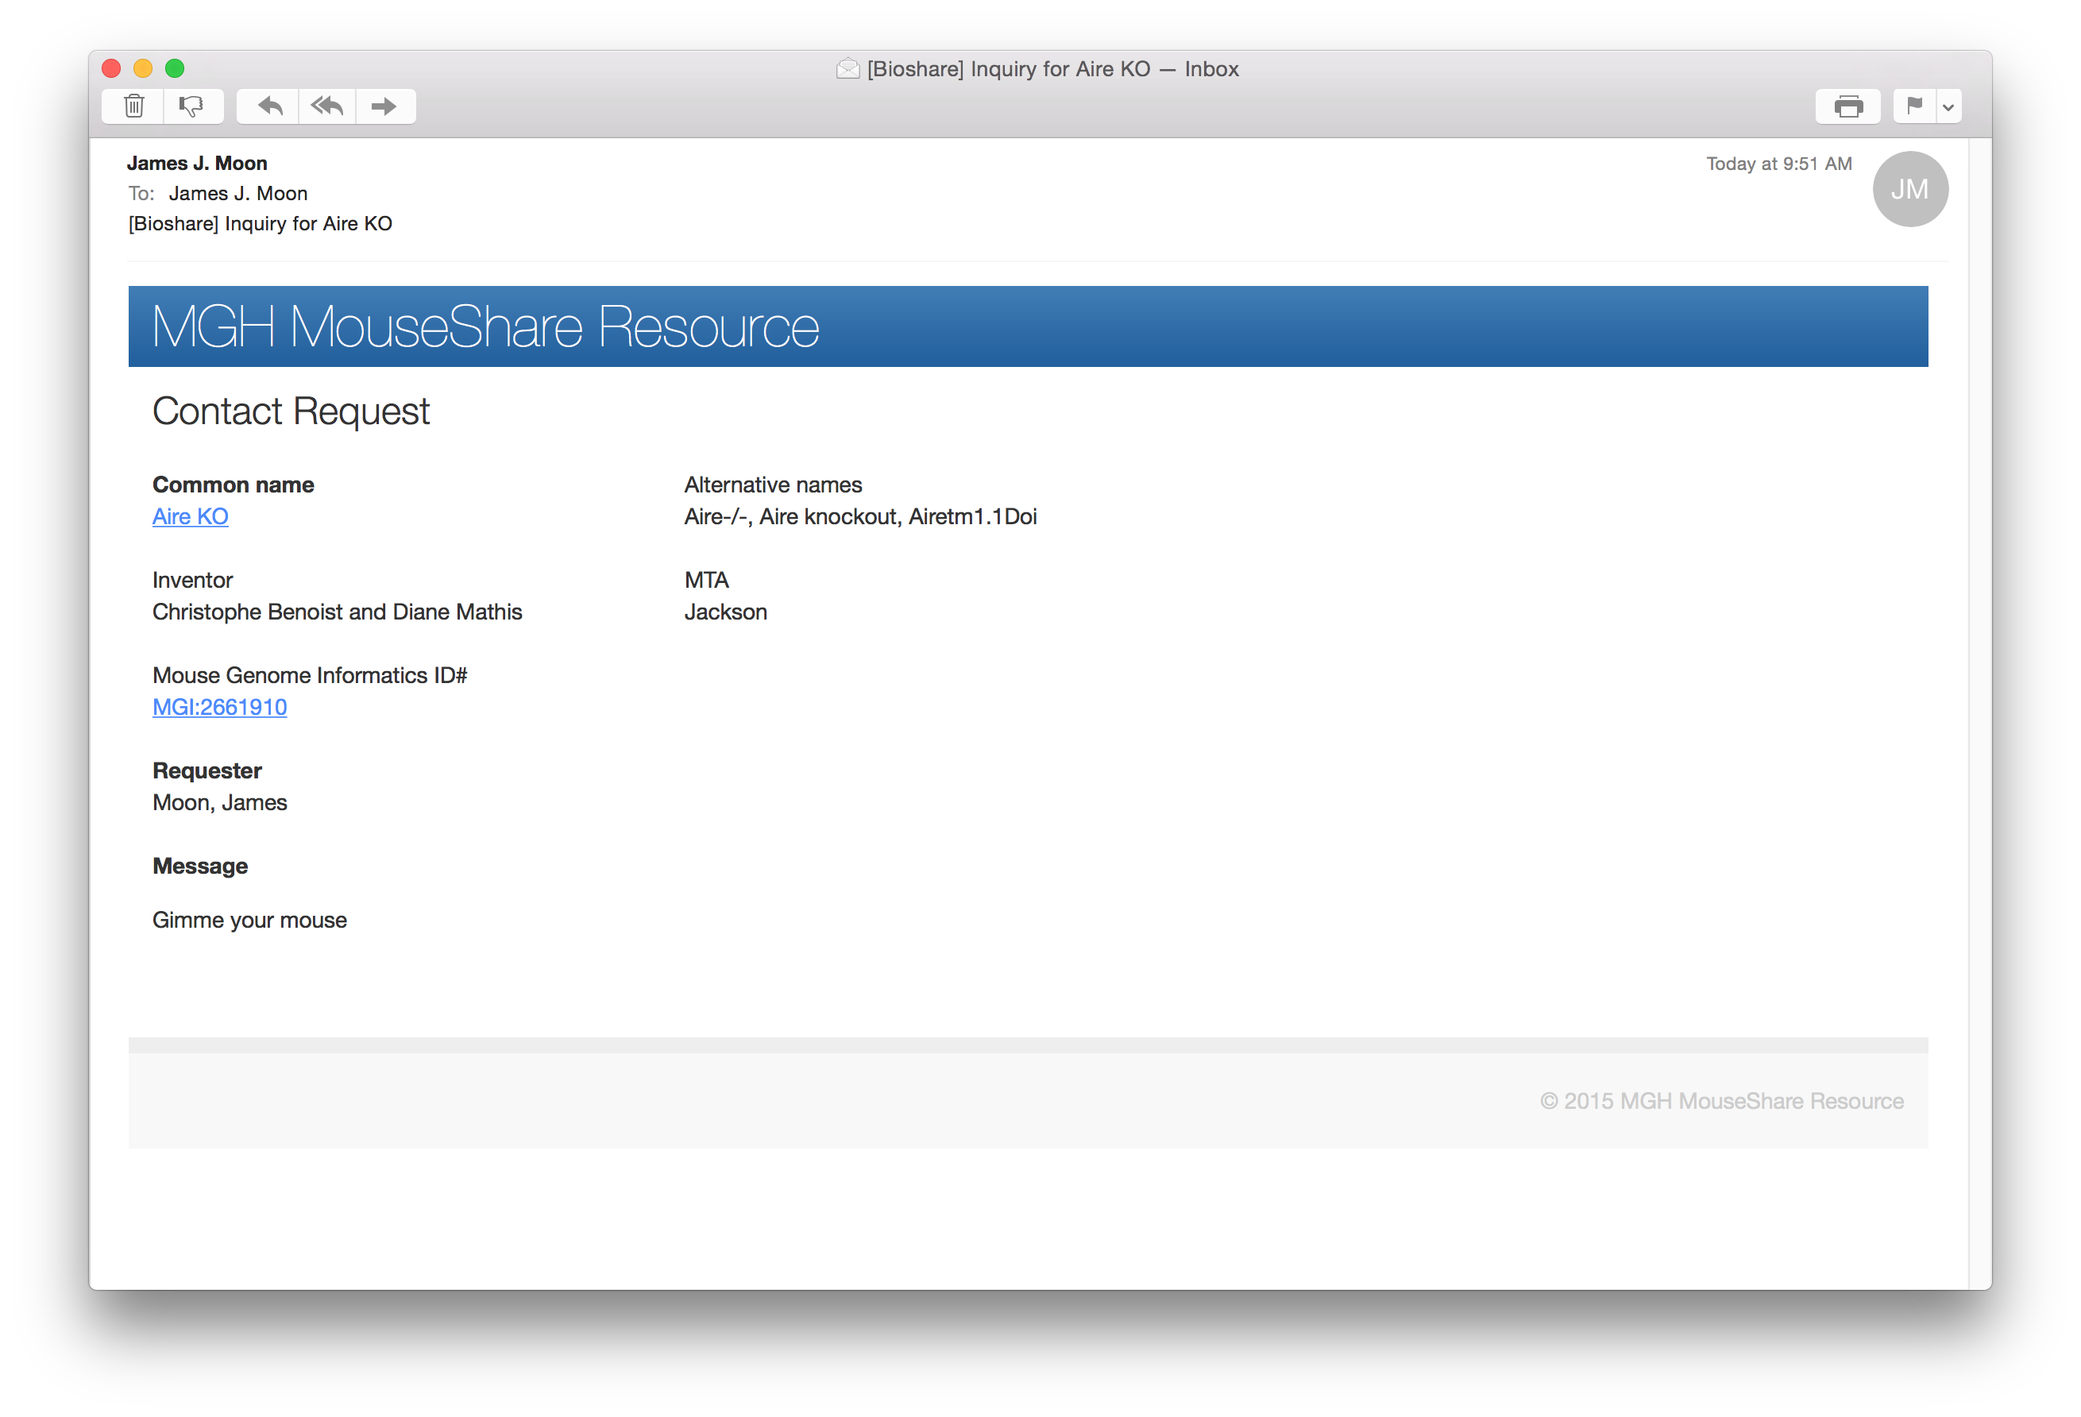

Slide 20
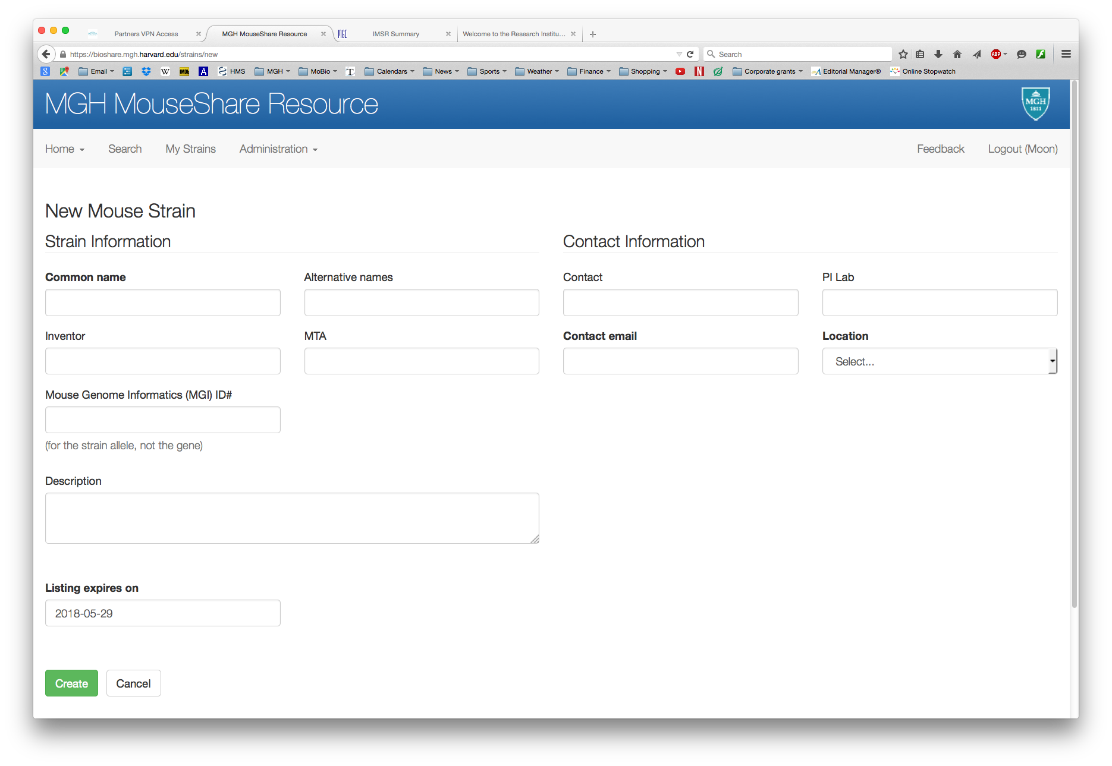

Slide 21
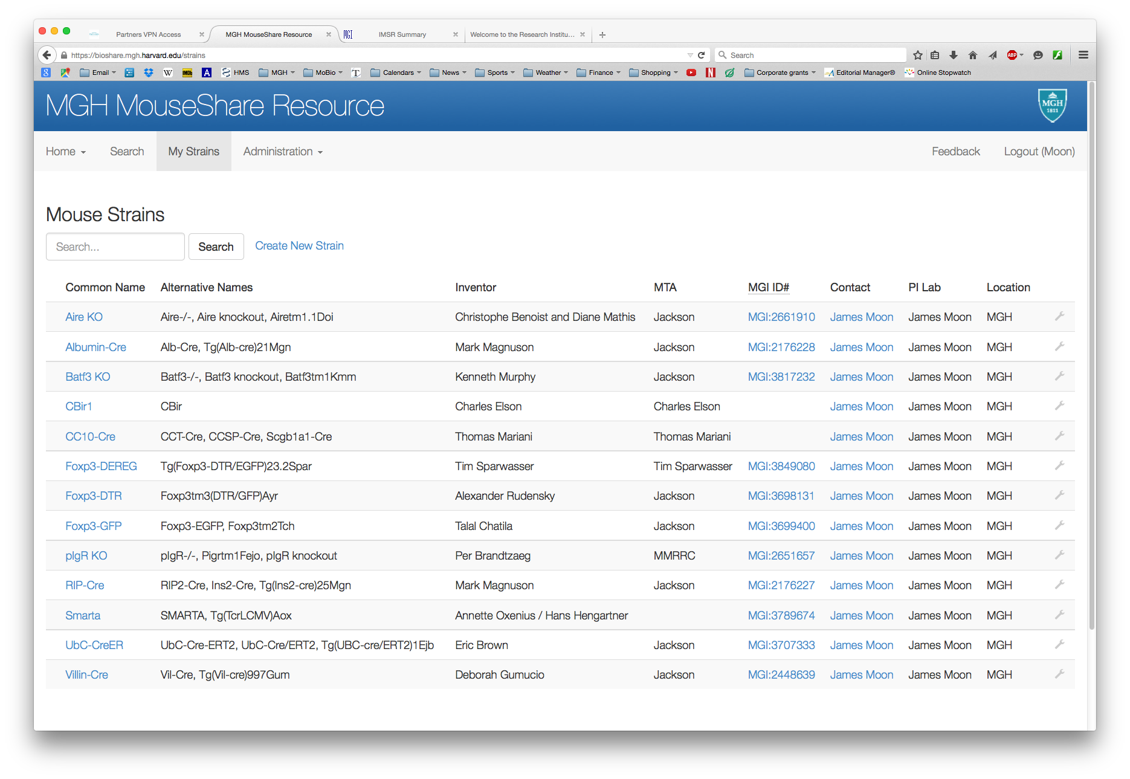

Slide 22
MGH BioShare Resource
Mice
Antibodies
Other Animals
Cell Lines
Plasmids

