Slide 1
CROI 2.0
What’s Next
for
Continuous Research Operations Improvement?
Harry W. Orf, PhD
MGH SVP for Research
1 June 2015

Slide 2
Order of Presentation
Background and History
Current Status
What’s Worked (Successes)
What Hasn’t (Things to Fix)
Working Toward an Improved CROI (version 2.0)
External Review – Alan Robinson
Internal Review – Retreat
The New Process

Slide 3
Background and History
WHY?
Good Business Practice – Listen to your customers
“Prime Directive” for Research Support
Focus on the researcher. Further the research mission and bring value to it. Maximize the researchers’ time “at the bench” by eliminating or maximizing the efficiency of their ancillary obligations.
Accordingly to a national survey by the Federal Demonstration Project, PI’s spend an average of 42% of their time on administrative activities.
HOW?
Leverage technology to improve communications and operations
Publicly monitored to: provide accountability
promote transparency
build trust

Slide 4
Background and History
Current CROI program launched October 2012
BUT......
In 2012, Research Operations Improvement was
NOT
a new concept at MGH…..

Slide 5
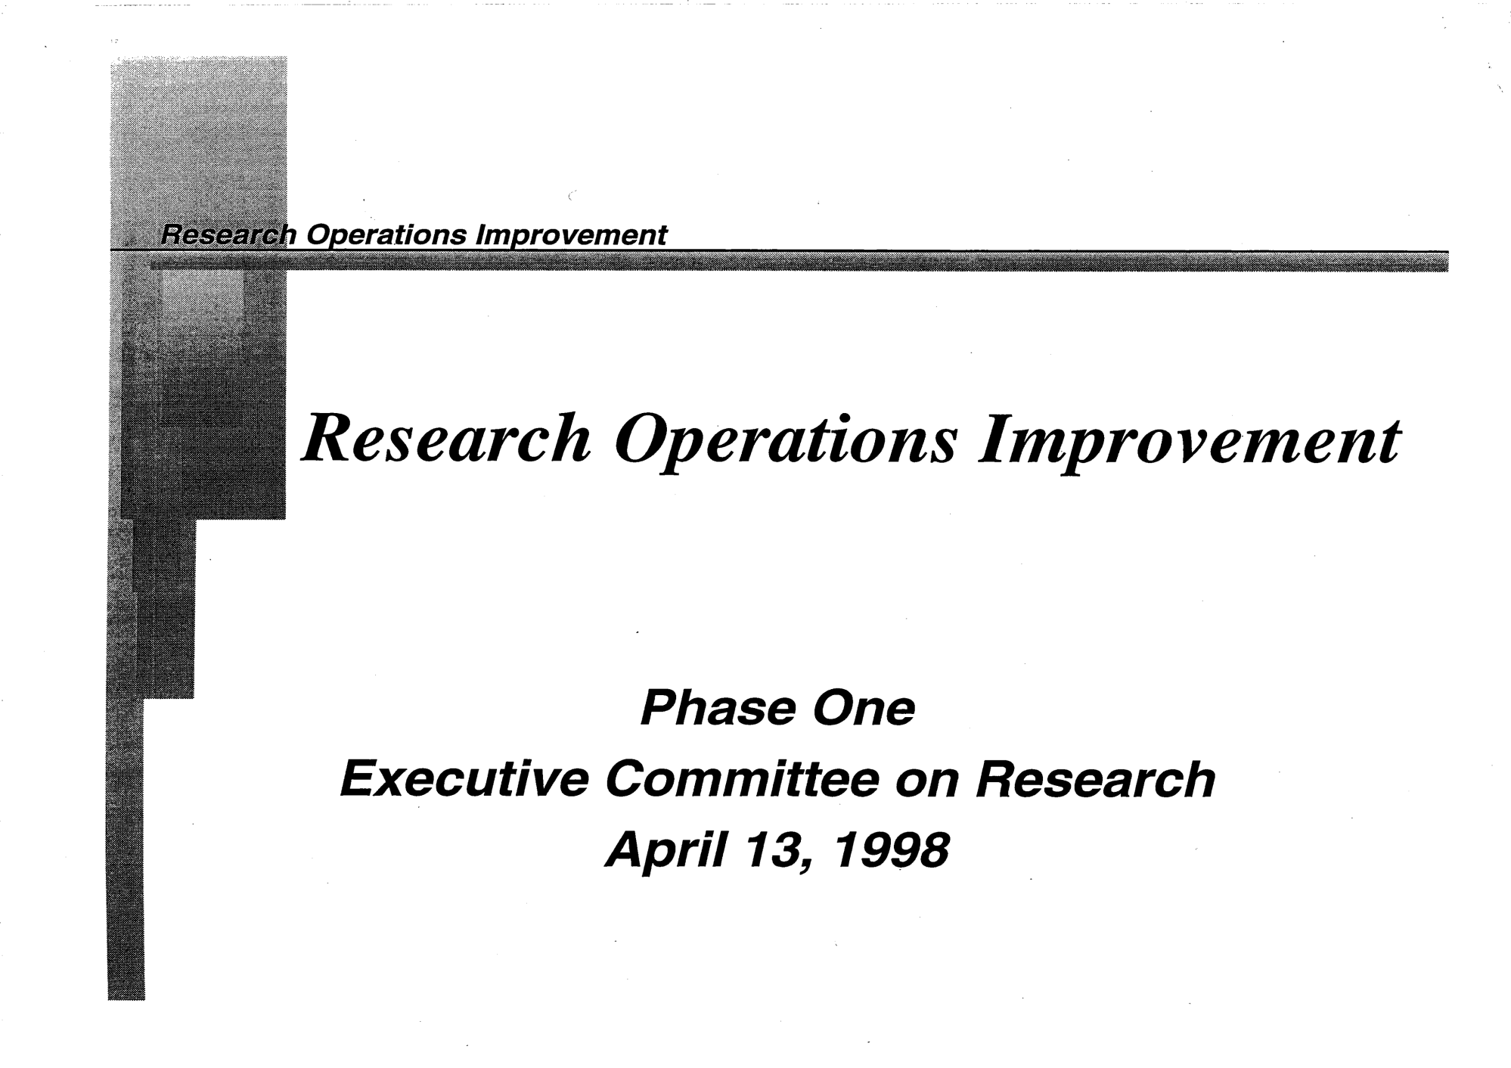
Background and History

Slide 6
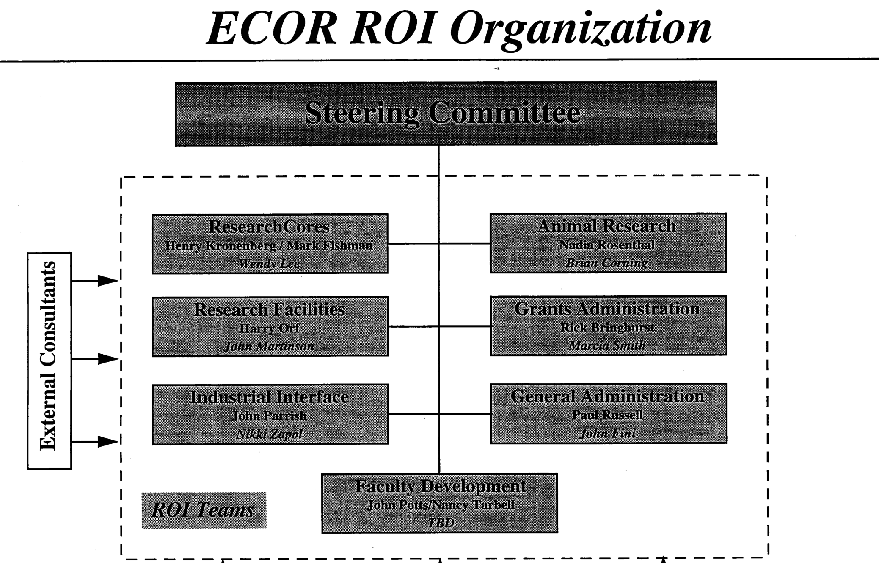
Background and History

Slide 7
Background and History
1998 ROI Project led to some major improvements
(establishment of Center for Faculty Development)
BUT......
The Project Ended!
Needed a way to continuously hear from
our research community

Slide 8
Background and History
Dr. Alan Robinson
Front-line workers* see a great many problems and opportunities that their managers don’t.
* researchers and research support staff

Slide 9
Current Status
Working Group | Open | New* | Resolved | Closed** | Submitted
Animal Care | 28 | 1 | 28 | 0 | 57
Central Data | 2 | 0 | 0 | 0 | 2
Clinical Research | 74 | 0 | 5 | 10 | 89
Communications | 1 | 0 | 5 | 3 | 9
Compliance | 2 | 0 | 5 | 1 | 8
Grant Tracking | 1 | 0 | 1 | 0 | 2
Human Resources | 11 | 1 | 14 | 6 | 32
Internet | 4 | 0 | 1 | 0 | 5
Intranet | 3 | 0 | 4 | 1 | 8
IT Infrastructure | 7 | 2 | 35 | 1 | 45
Materials Management | 8 | 2 | 54 | 8 | 72
Research Management | 37 | 0 | 34 | 26 | 97
RVL | 2 | 1 | 9 | 0 | 12
Safety | 6 | 0 | 10 | 0 | 16
Space and Facilities | 11 | 0 | 29 | 8 | 48
Totals | 197 | 7 | 234 | 64 | 502
*New – Workgroup needs to input summary and status
**Closed – Unable to change (e.g., request to change cost transfer policy) OR already done!

Slide 10
Current Status

Slide 11
Current Status
Suggestions Over Time
Launch
Year 1 Anniversary

Slide 12
What’s Worked (Successes)
234 Suggestions/Ideas Implemented
Impactful, Visible Examples
Research Staff Appreciation Day
Over 1600 non-faculty/postdoc/grad student/admin/animal tech
Research Core Days
Twice per year, alternate between CNY and Main Campus
Academic Discounts
Purchases on research funds treated as educational
More Timely Vendor Pricing Updates
Led to additional research contract specialist

Slide 13
What’s Worked (Successes)
Impactful, Visible Examples (cont.)
Streamlined eCOI
“No to all” button saves 100+ clicks
Warning when InfoEd and Insight about to Time Out
Prevents loss of unfinished applications and protocols
Vastly Improved Research Intranet
Current site upgraded/reorganized. Added “Help and How To” Section
Available outside firewall
IRB Improvements
New IRB Helpline established
Commercial IRB approved for external studies (increase throughput)
IRB PI protocol status dashboard developed

Slide 14
What’s Worked (Successes)
Impactful, Visible Examples (cont.)
IT Infrastructure
Helpdesk phone # added to Helpdesk emails.
Estimated pricing for IT and phone services added to website.
Windows 7 Upgrades – hospital covers cost and, if needed, replacement!
PEAS – Partners Enterprise Apple Support with free Office
iPad purchases for research now allowable w/o CFO approval
Email – Everyone at MGH now has xxx@mgh.harvard.edu address!
Completely New Weekly Research News
One screen, one liners, once a week

Slide 15
What’s Worked (Successes)

Slide 16
What’s Worked (Successes)
Coming Soon!
New Automated Visa System in PIO
Dramatic simplification of process, all electronic, links to govt system
Elimination of Annual Recredentialling of Non-Clinical Staff
Will save hundreds of admin work hours per year
eIACUC 4.0
Multitude of improvements, drop down menus, etc.
CCM Facility Access and Orientation Training Online
Done through Healthstream at researcher’s convenience

Slide 17
What Hasn’t Worked (Things to Fix)
Poor Participation – Too Few Contributors 6000 res. personnel, 500 suggestions over 3 years, 195 unique suggestors Only 3% participation
Poor Publicity Participation increases when presentations remind people of program
Too Many Suggestions Stalled for Many Months Resources outside MGH needed, no prioritization at Partners level Poor use of faculty’s time when working groups do not make progress
Some “Resolved” Suggestions Were Really Not Fixed An explanation of why something cannot change is not a resolution
Tracking Program Not Easy to Use, Update Reporting on progress made posted late or not at all

Slide 18
Working Toward an Improved CROI
Get Expert External Evaluation – Dr. Alan Robinson
Two Site Visits, Interviews with suggestors, working groups, staff
Recommendations for Improvement
Organizational Alignment
Process
Training and Education

Slide 19
Working Toward an Improved CROI
Robinson Recommendations
Improve Organizational Alignment
Need cross-functional mechanisms to fix problems across entire organization
Must have buy-in and participation across Partners
Business owners who control resources must be involved
More people – must be part of their regular work routine

Slide 20
Working Toward an Improved CROI
Robinson Recommendations
Process
Improve electronic tracking system
Need hierarchy and/or prioritization of suggestions
Calling it a suggestion box may be a negative
Clarify the status of each suggestion
Increase of awareness of the program and celebrate successes

Slide 21
Working Toward an Improved CROI
Robinson Recommendations
Training and Education
Leadership – support and involvement in oversight
Workgroups – persistence and idea owners
Research community – small ideas lead to big impacts
All – understand the benefits of an Idea Driven Organization

Slide 22
Working Toward an Improved CROI
Major Review/Revision of CROI Program
Grew from Robinson Recommendations
Brainstorming Session with CROI Leadership
Interviews with Working Group Leaders
Retreat – Plan New Version of CROI (2.0)
Break-Out Session Topics
Research Community Experience
Processing Ideas
Marketing, Publicity, Awareness

Slide 23
Working Toward an Improved CROI
Research Community Experience
Add web-based suggestion form to email and phone
Allow feedback from all on suggestions (Facebook ‘like’)
Personal communication between suggestor and idea owner
Require suggestions to be more structured, suggest categories
Only allow one suggestion per submission
Create an ‘App’ for suggestions (social media)
Create short video on how and why
Have “issue of the month” – featured problem area (e.g. HR)
Have working groups hold annual retreat on their issues
Suggestors must confirm resolution of issue
Every electronic submission should have option to comment

Slide 24
Working Toward an Improved CROI
Marketing, Publicity, Awareness
Publish quarterly "From the Desk Top” with successes
Create a campaign to help draw awareness to the program
Give regular presentations highlighting successes
Research Council, Clinical Research Council, RADG, etc.
Create an app to submit and provide status of ideas
Look at other social media venues to communicate successes
Highlight a success each week in the Research News
Have an "Idea Fair" similar to Core Day
Change the name from CROI to a new name

Slide 25
Working Toward an Improved CROI
Processing Ideas
Make work groups topic based, use existing entities
Working groups report to business owners
Standardize processes across all working groups
How often they meet, membership, agenda format, etc.
Need a process to prioritize suggestions
Convene faculty around focused set of issues
Give each suggestion an “owner”
Solicit ideas through a "Process of the Month”
Have “parking lot” for good ideas that cannot be done now
Senior management conducts final review of all “No’s”

Slide 26
Idea Submission
CROI 2.0 Idea Processing Work Flow
Tracking Ideas
Partners
Validation by admin owner and working group
Parse
Operational area assigned
Institution specific
Yes
but will need resources
Yes No additional resources needed
No
B/O brings to resource body for approval
Business Owner Review
JUST DO IT
Yes but no resources available now
Yes with resources provided now
No resources available
B/O Agrees with “NO”
B/O Disagrees with “NO”
Implement
Parking Lot
Begin implementation
B/O Reports “NO” to ROM
RESOLVED
ROM reviews semi annually
RESOLVED Inform suggestor
ROM Reviews
Confirm resolution with suggestor
Confirm resolution with suggestor
ROM Agrees with “NO”
ROM disagrees with “NO”
CLOSED Inform suggestor

Slide 27
Working Toward an Improved CROI
Partners, MGH, and BWH Senior Research Management
have committed to the new CROI Process
Work is underway with Partners to establish new groups and
an internal process
Coming this Fall………
CROI 2.0 – “I Suggest”

Slide 28
CROI
CROI has become and will remain an integral part of our research support process. It’s here to stay!
We need everyone’s help to keep improving!
suggest@research.mgh.harvard.edu
Thanks for your attention!
Questions?

