Slide 1
Problem: Clinical trial recruitment is a difficult task for all biomedical researchers. Many trials (nearly 80%) do not meet enrollment timelines and patient recruitment is very costly.
Opportunity: Partners has over 300,000 patients on Patient Gateway. Research indicates that many more patients would participate in clinical trials if they knew how to find/access them.
HOPE: An on-line patient community connected to Patient Gateway that will eliminate many of the current barriers to clinical trial recruitment enabling Partners researchers to more successfully recruit for clinical trials and better engage the Partners patient community in the research process.

Slide 2
How HOPE works:
Patient Actions:
Easily join focused communities (arthritis, depression, diabetes, heart disease) relevant to their health from Patient Gateway
See all current IRB-approved research studies relevant to their health and be able request participation in these studies
Receive useful targeted health information (e.g. educational materials, summaries of relevant research articles) and learn about upcoming focused events
Clinical Investigator Actions:
List trials on HOPE platform (open to researchers at all sites)
Directly reach out to patients that “opt-in” to one of the HOPE communities and recruit them to relevant human research studies
Distribute one time surveys/longitudinal questionnaires (only IRB approved protocols)

Slide 3
Impact on clinical practice:
Reduced recruitment burden
Reduced email traffic from researchers
Fewer posted signs in practices
Fewer patient recruiters in practices
Streamlined clinical recruitment
Impact on patients:
Patients will be more aware of the research opportunities at Partners
Patients will have easier access to clinical trials
Patients will be more educated about their health conditions

Slide 4
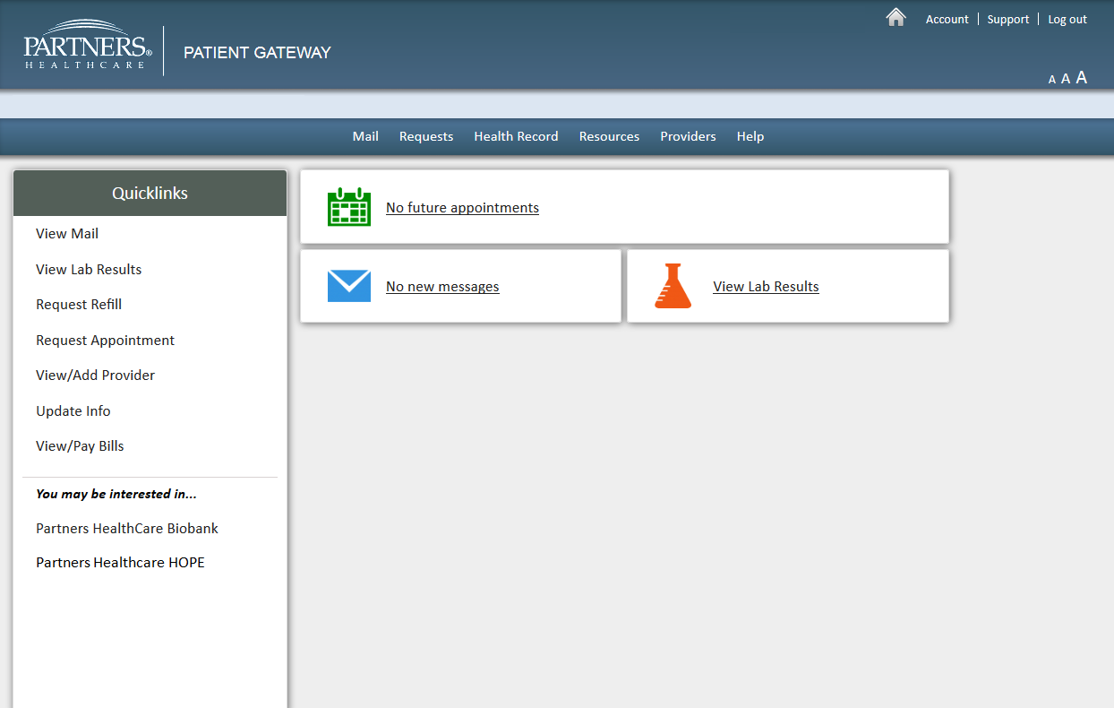
HOPE Patient Gateway Quicklink

Slide 5
HOPE Introductory Welcome Page
*Note: HOPE platform will have language on the introductory welcome page that communicates that this is a pilot and, though it only focuses on a few health conditions initially, it will likely expand to additional health conditions in the future. Current copy on page is not final.

Slide 6
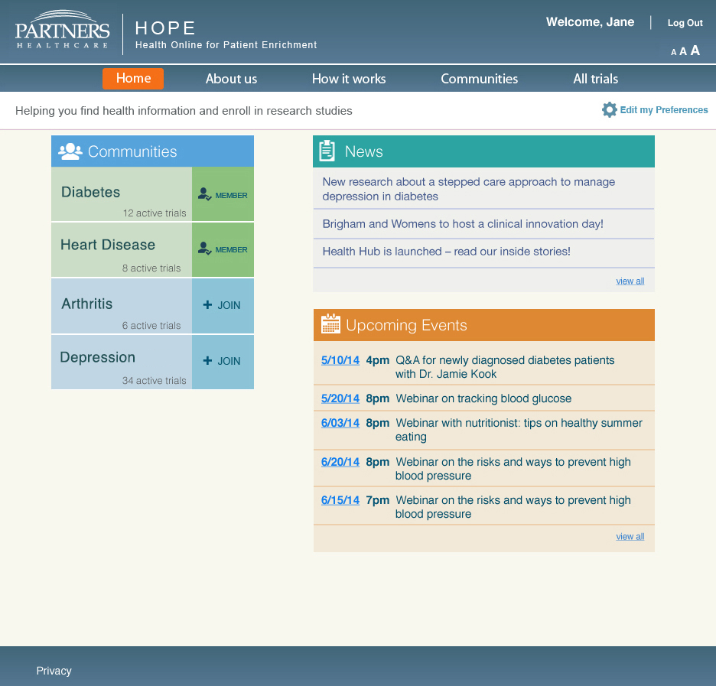
HOPE Home Page

Slide 7
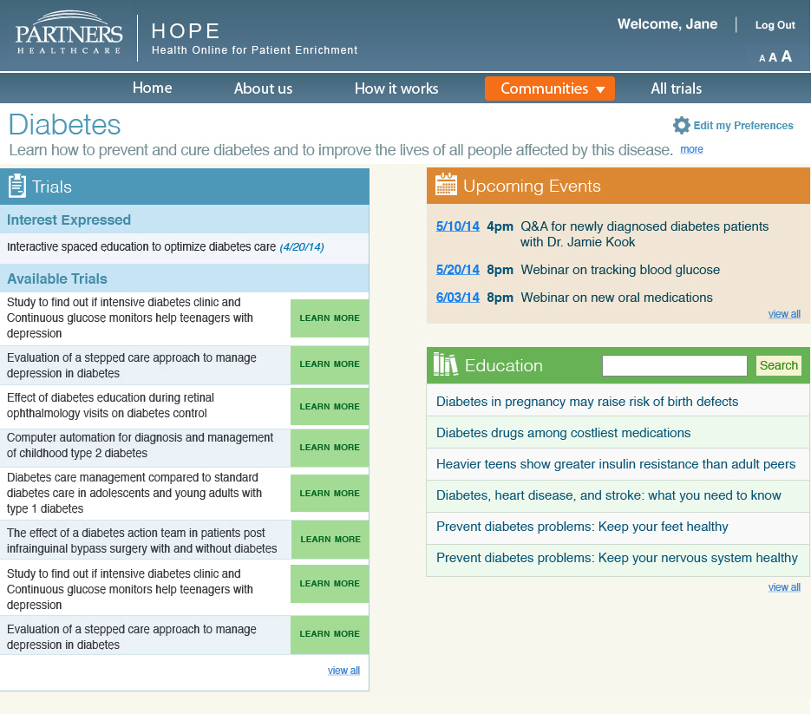
HOPE Community Page

Slide 8
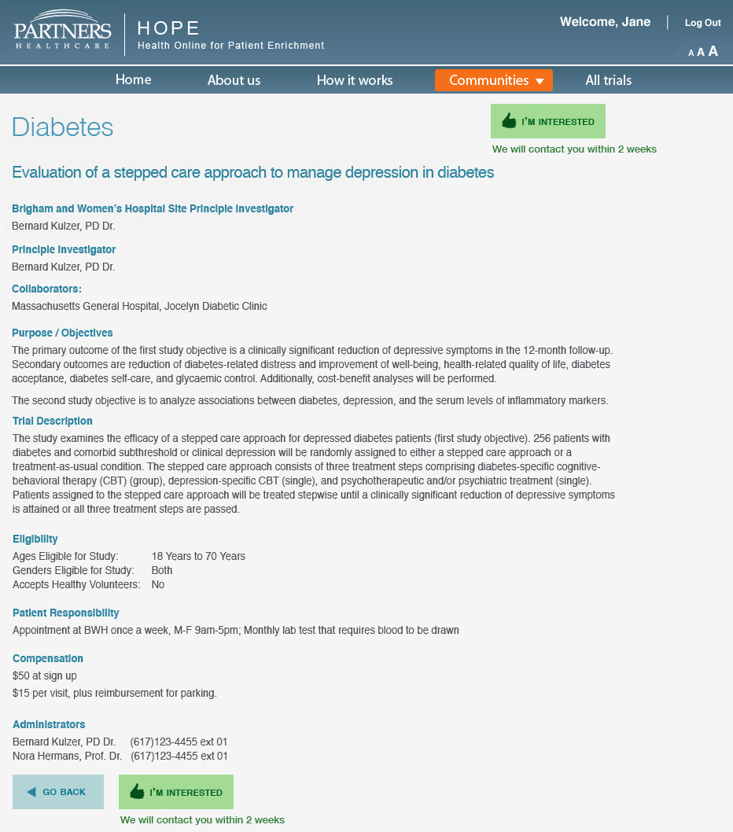
HOPE Example Clinical Trial

Slide 9
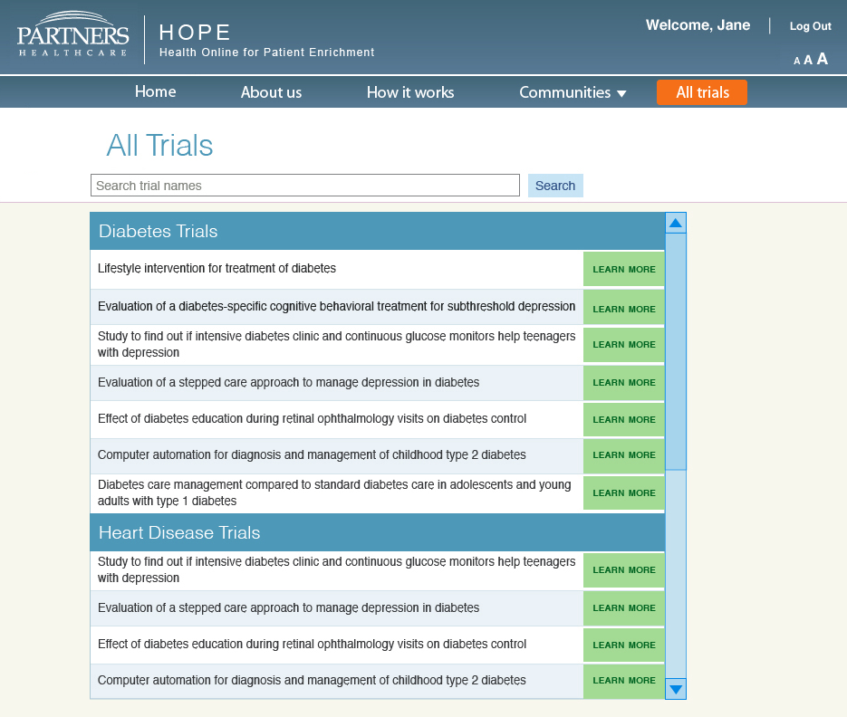
HOPE Clinical Trials Search

Slide 10
Updates
Platform design finished. Development currently underway
Scheduled to be available in production on February 26, 2015
Platform content will be populated in February
Planning to launch a soft roll out and begin patient outreach in late February/early March
Currently recruiting arthritis, depression, diabetes and heart disease human research protocols

Slide 11
Protocol Submission
Go to the PCERC website*:
Google “PCERC” or
Go to the following url: brighamandwomens.org/research/centers/pcerc
Click on “Partners HOPE” on the left hand navigation
Download the “HOPE Protocol Submission Form
Complete the form and email it to Josh Di Frances (jdifrances@partnes.org)
*Instructions also on distributed handout

