Slide 1
Boston Biomedical Innovation Center (B-BIC)
A unique consortium of academia, government, non-profits, industry, and venture capital
PIs: Joe Loscalzo, MD, PhD, BWH ; John Parrish, MD, MGH & CIMIT ; David Golan, MD, PhD, HMS
Notes:
About 30% heart, 30% blood, 20% lung, else other
About 50% device, 30% therapeutic, 15% diagnostic, else other

Slide 2
Boston Biomedical Innovation Center (B-BIC)
Supports academic investigators developing devices, diagnostics, and therapeutics addressing heart, lung, blood and sleep disorders
An NIH National Center for Accelerated Innovation (NCAI)
Notes:
About 30% heart, 30% blood, 20% lung, else other
About 50% device, 30% therapeutic, 15% diagnostic, else other

Slide 3
B-BIC Is Focused on Commercialization
Accelerates translational research, and address gaps in early-stage funding, access to external resources/expertise, and commercialization skills
Academia
Commercial Sector
B-BIC Activities
& Partnerships

Slide 4
B-BIC Provides Significant Support to Investigators
PILOT grant
Up to $50,000 plus overhead, Proof-of-concept, 1 year
Rolling submission
DRIVE grant
Up to $200,000 plus overhead,
Proof-of-value, 1½ - 2 yrs Rolling submission
Grant Funding
Project Management, Coaching
Skills Development
Customized milestone & critical path development; Commercialization & IP strategies & tactics
Customized education for individuals; Broad education for all
External Partnering
Development
FDA, CMS, USPTO, OTAC
Commercialization
Industry, Venture Capital

Slide 5
A more scientific framework…
EP
Co
EP
–
–
–
PI_{t} + BBIC
PM = = SD
– Co
Co –
fPI_{t}
Energy,
Time
–
–
–
EP
Co
EP

Slide 6
B-BIC Grant Recipients
A Blood Coagulation Sensor for Point of Care Use
Seemantini Nadkarni, PhD, Wellman Center, Massachusetts General Hosp.
A Biomimetic Human Platelet Bioreactor
Jonathan Thon, PhD, BWH, and Joseph Italiano, PhD, BWH
Portable MR Device for the Pulmonary ICU
Samuel Patz, PhD, Brigham and Women’s Hospital
Development of an Implantable Intracardiac Robotic Right Ventricular Ejection Device
Nikolay Vasilyev, MD, Boston Children’s Hospital

Slide 7
B-BIC Proposal Development & Review Process
B-BIC supports investigators throughout the grant submission process
Coaching on market analysis, clinical applications, IP, commercialization, technology
Key milestones and project critical path developed
Skills development consultation
External Review
Pre-Proposal
Full
Proposal
Award Decision
Federal Partners

Slide 8
How To Get Engaged with B-BIC
Visit:
www.b-bic.org

Slide 9
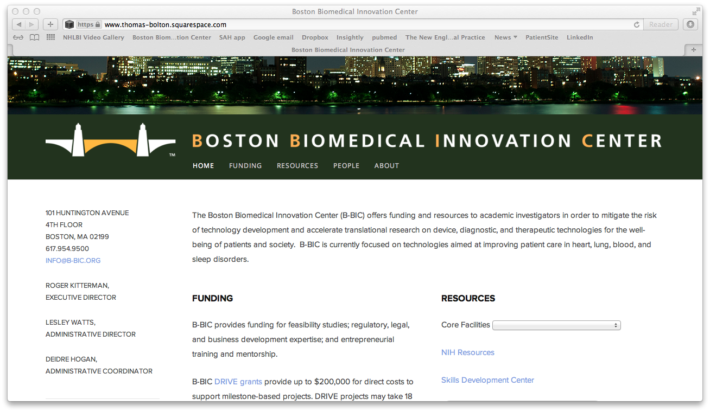
B-BIC Website

Slide 10
How To Get Engaged with B-BIC
Contact B-BIC resources:
Site Miner, Domain Expert, Lesley Watts or Paul Tessier
(contact info on web site)
Submit pre-proposal:
Work with B-BIC resources

Slide 11
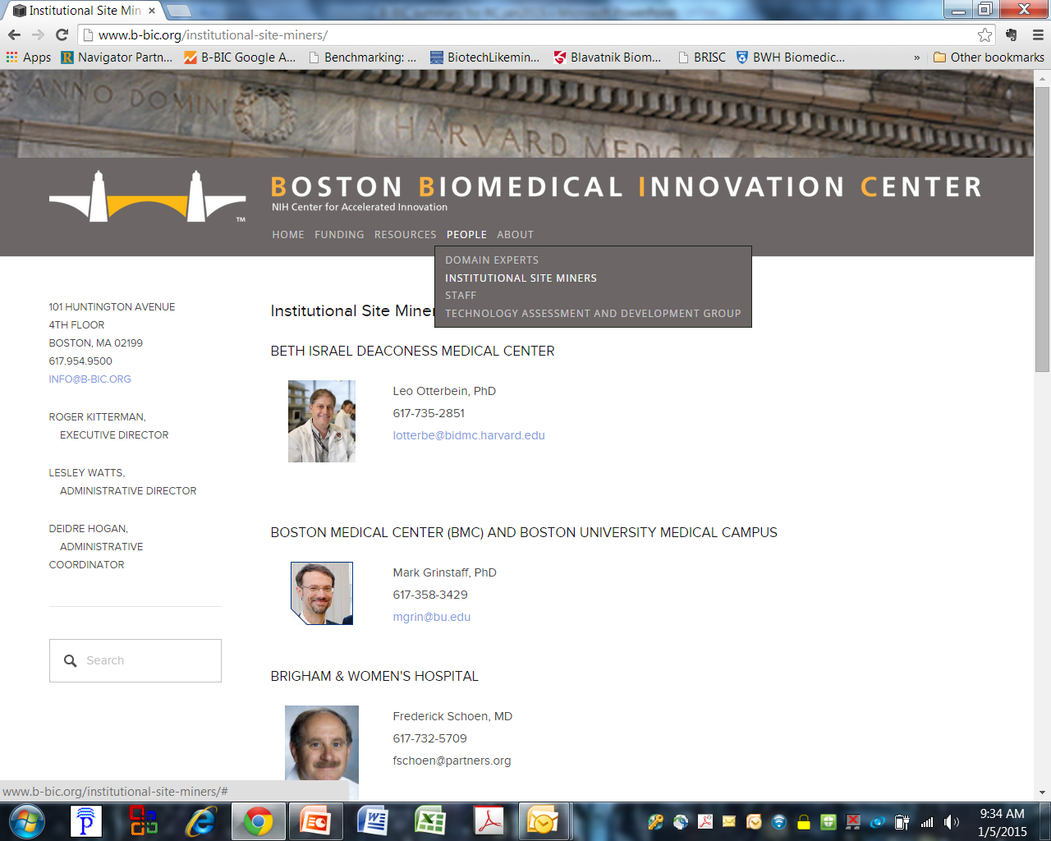
How To Get Engaged with B-BIC

