Slide 1
United by research.
Driven by hope.

Slide 2
Challenges
Shrinking and Shifting Federal Funding Base
Fewer Federal Grant Dollars….2013, down 8%, 640 fewer grants
Harder to Get….Success rate average now 17%, single digits in many centers
Funding Being Re-Directed Toward Translation and Outcomes….
Threatens established programs, discourages new ones
Limits ability to engage industry, donors, public
The MGH Research Enterprise is the Best Kept Secret in Boston
“Jack Szostak of Harvard and HHMI wins the Nobel Prize……”
Frustrated resesarchers, low productivity
Ever-Increasing Regulations/Bureaucracy
Researchers spend an average of 42% of their time on administrative tasks!
Need new approaches to translate discoveries
The Translational Research “Valley of Death”
Most innovative discoveries are never reduced to practice, never become products

Slide 3
Goals of the Strategic Plan
Reaffirm Commitment to Basic Research
Strengthen funding base
Integrate Research and Clinical Missions
Speed translation of discoveries to practice
Engage our patients as partners in research
Increase Our Visibility
Access to industry, donors, collaborators, venture capital
Broaden Engagement with Industry
Improve Infrastructure and Internal Communication
RESULT: Creation of the Mass General Research Institute

Slide 4
The Mission of the Research Institute
Guide
Promote
Support
Notes:
Harry described to you the ‘why’, now I’d like to tell you a bit about the mission of the Research Institute and how my office will work within the Research Institute to support this mission.
The Research Institute was created to Guide, Support, and Promote the amazing research enterprise at MGH.
Internally, it will foster increased communication and collaboration, and externally it will serve as the ‘front door’ to MGH research.
The over-arching goal is to increase support, both in terms of infrastructure and hard money, for our investigators so they can spend more time focusing on science.

Slide 5
The Research Institute will guide your science by:
Supporting the ongoing efforts of ECOR to guide MGH research policy
Your voice – ECOR elected representatives
Creating a Division of Clinical Research to unify all hospital programs that serve the clinical research community
Maurizio Fava, Director
Creating the Translational Research Center which will enable our investigators to turn their discoveries into products
Mason Freeman, Director
Catalyzing large-scale collaborations and disease-based research programs across MGH
Guide
Promote
Support

Slide 6
The Research Institute will support your science by:
Directing a Continuous Research Operations Improvement program
Harry Orf, Sr. VP
Enabling more formal and thoughtful planning of shared resources
Research space, cores, internal funding
Bringing departments that support research into the research management reporting chain
Materials management, IT, EH&S
Supporting the Biobank, which will provide a tremendous resource for our investigators
Jordan Smoller, co-Director
Guide
Promote
Support

Slide 7
The Research Institute will promote your science by:
Guide
Promote
Support
Focusing on marketing and “branding” MGH research
United by Research. Driven by Hope.
Fostering more productive engagements with external partners
Funding agencies, industry, donors
Engaging our patients so they can participate in research
Clinical trials, Biobank

Slide 8
MGH Total Research Revenue
MGH total (Direct + Indirect) research revenue has grown 208% since FY99 to $760M in FY14.
Notes:
All Other = Endowment/Gifts (21%), Subcontract/Non-Profits (16%), Foundation (7%),
In FY14, the NIH share of revenue down is 2% from last year and down 5% overall from FY12
NIH Funding is their definition of what we can spend, Actual Research Expenditures/Revenues reflects our actual activity.
We did have lower DHHS expenditures in FY14 versus FY13 for two main reasons.
NIH funding authorization typically arrives late in Q4, and
in FY14 we spent less than our NIH Funding would indicate. For much of FY14 we operated under reduced funding guidance as a result of Sequestration.
This dynamic will lead to higher FY15 expenditures/revenues on MGH’s books.

Slide 9
MGH Research by Sponsor FY14 Direct and Indirect Revenues $760M
down 2% from FY13
down 5% since FY12
Notes:
In FY14, the NIH share of revenue down is 2% from last year and down 5% overall from FY12
NIH Funding is their definition of what we can spend, Actual Research Expenditures/Revenues reflects our actual activity.
We did have lower DHHS expenditures in FY14 versus FY13 for two main reasons.
NIH funding authorization typically arrives late in Q4, and
in FY14 we spent less than our NIH Funding would indicate. For much of FY14 we operated under reduced funding guidance as a result of Sequestration.
This dynamic will lead to higher FY15 expenditures/revenues on MGH’s books.

Slide 10
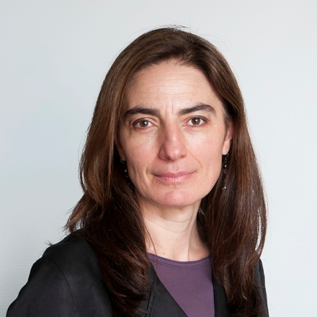
The Research Institute will promote your science by:
Working with our investigators to create an “MGH Research Portfolio”
Training our investigators to market their research
Working with Partners Innovation and the Market Sector Leaders to identify and exploit new opportunities at all stages
Consulting with the Research Institute Advisory Council Strategic Alliance Committee
Gabriela Apiou, Ph.D., Director of Translational Research Training and Development

Slide 11
The Research Institute will promote your science by:
Working with the Development Office to engage donors and participate in fund-raising activities and events
Teaching the donor community about basic research
Training our investigators to effectively engage with donors
Consulting with our Research Institute Advisory Council Advancement Committee
Thanks to Mary Hanifin, Kate Gutierrez, Laura Henry, and Deborah Farr

Slide 12
The Research Institute will promote your science by:
Increasing marketing efforts to spread the word about MGH research
Working to keep MGH Research in the news
Partnering with our investigators to get the word out
Publishing, press releases, signatures, slides, etc.
Facebook, twitter, tumblr, etc.

Slide 13
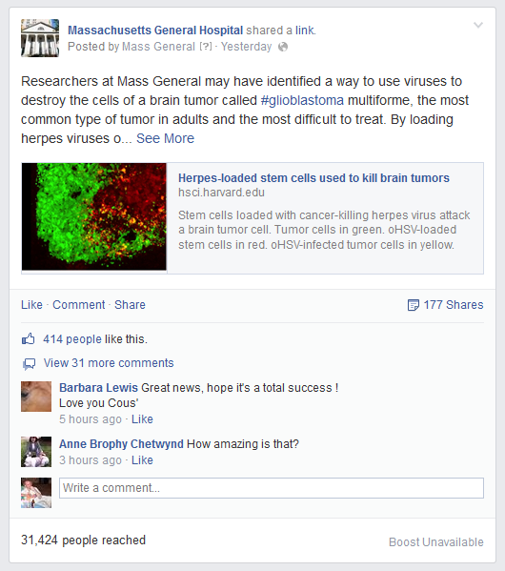
Why is it Important to Market our Research?
When we tell people our stories, they will respond…..
“Great research!”
“Hopefully fewer people will have to suffer from this….”
“Awesome research…makes you think there is a cure for everything, somewhere, sometime”
This is so cool. Thank you MGH for always being out there in front…”
“ MGH– My family will forever be grateful for research like this.”
“How amazing is that?”
Follow us! Like us!

Slide 14
Take home thoughts….
Through endorsement of the Strategic Plan, Research has become an institutional priority
The Research Institute will guide, promote, and support YOUR science
Times are changing, and we must evolve to remain at the top
“When a distinguished but elderly scientist states that something is possible, he is almost certainly right. When he states that something is impossible, he is very probably wrong.” Arthur C. Clarke

Slide 15
The Research Institute is……

Slide 16
Thanks:
Alison Hoffnagle
Bonnie Bounds
Gabriela Apiou
Brian Burns
Maire Leyne
Gary Smith
Sarah Alger
Maureen Larkin
Rick Haigis
Richard Averbuch
Donna Lawton
Colleen Delaney
Ann Skoczenski
Mike Morrison
Mary Hanifin
Peggy Slasman
Deborah Farr
Michelle Staats
Robert Tomsho
Kate Gutierrez
Michele Gagne
Arch MacInnes
Gaurdia Banister
Sara Looby
Harry Orf
Bob Kingston
David Louis
Maurizio Fava
6000 People One Institute United by Research Transforming Medicine

Slide 17
United by research.
Driven by hope.

Slide 18
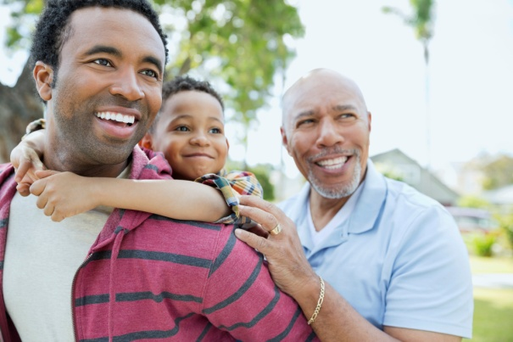
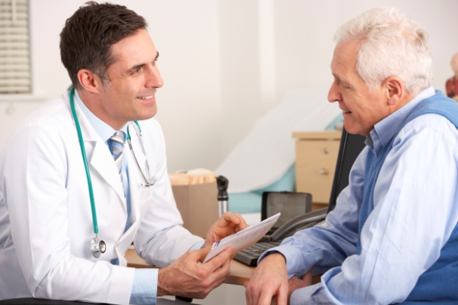
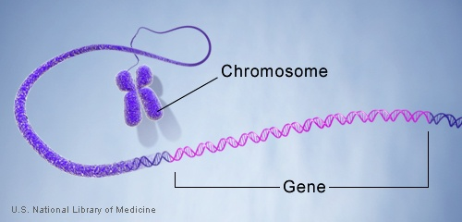
Partners Biobank at MGH
A Resource for Investigators
Jordan Smoller, MD ScD

Slide 19
Partners Biobank
The Partners Biobank is a repository of consented patient samples linked to the electronic medical record and supplemented with health information/family history from surveys.
To date, more than 25,000 patients have consented to participate in the Partners Biobank. The target is 75,000 consented patients by 2018.

Slide 20
Research Translates into Better Clinical Care
Consent
Samples
Data
Research Discoveries
Improved Clinical Care for All Patients

Slide 21
Provides investigators with:
Consent for broad-based research
Consent for return of actionable results
Consent for re-contact for info and/or samples
Serum, plasma, DNA
Can collect 2 additional tubes with collaborating studies
Can collect discarded tissue samples
Low cost and available immediately
Link to electronic medical record
Self-reported data on family history, lifestyle, environment
Coming soon: GWAS data for 25,000 patients
Powerful and state-of-the-art query tools: The Biobank Portal
Validated disease populations
Calculated healthy controls

Slide 22
Disease Phenotypes Based on ICD-9 Codes
Phenotype | Frequency* | Phenotype | Frequency*
Hypertension | 11,605 | COPD | 3,671
Hypercholesterolemia | 10,989 | Kidney Disease | 3,389
GERD | 7,246 | Osteoporosis | 3,051
Cardiac Arrhythmia | 6,972 | Sleep Apnea | 2,583
Ischemic Heart Disease | 5,919 | Migraine | 2,474
Thyroid Disorders | 5,814 | Breast Cancer | 1,272
Obesity | 5,261 | Epilepsy | 1,156
Depression | 5,074 | Ischemic stroke | 1,078
Asthma | 3,914 | Prostate Cancer | 972
* Based on ICD-9 code counts among 22,000 consented Biobank subjects

Slide 23
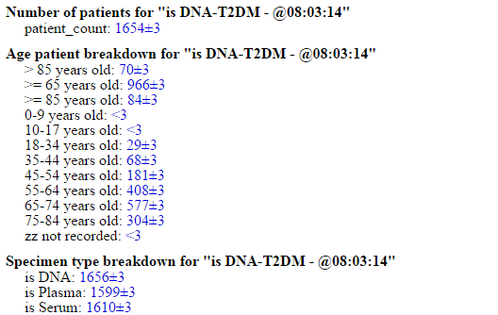
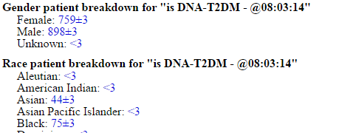
Query Results: DNA for T2D
22

Slide 24
Genotyping/Transcriptomics
Genomewide Genotyping (N=25,000 subjects)
Illumina Multi-Ethnic GWAS/Exome SNP Array (MEGArray)
Size: 1.6M SNPs
Plus custom content: >60,000 loss of function variants
Pricing agreement: up to 50K samples by 2018
Transcriptomics by RNA-Seq (N=10,000 subjects)
TruSeq stranded mRNA library construction
Illumina sequencing: ~30M reads/sample
Pricing agreement: up to 20,000 samples (or till 2018)
5,000 Samples
Feb 15
Illumina FastTrack
10,000 Samples
Translational Genomics Core
End of 2015
Translational Genomics Core
End of 2016
10,000 samples

Slide 25
Data Integration: The Biobank Portal
The Biobank Portal is a query tool that allows Partners investigators to work with data of consented Biobank subjects.
Investigators can also initiate Biobank sample requests directly from the query tool.
Tool is now live and can be accessed here: biobankportal.partners.org
For help accessing the Portal and running queries we have created the Biobank Portal Wiki: biobankportal.partners.org/mediawiki/

Slide 26
Biobank Contacts
Co-Directors of the Biobank at MGH:
Jordan W. Smoller, MD, ScD
Susan A. Slaugenhaupt, PhD
Program Manager at MGH:
Alison Hoffnagle
ahoffnagle@mgh.harvard.edu
For information about:
Grant proposals
Sample/data requests
Recruitment
Please contact us at biobank@partners.org
To join: www.partners.org/biobank
25

Slide 27
United by research.
Driven by hope.

Slide 28
MGH Translational Research Center: What is it and how might it contribute to new therapeutics development worldwide ?
Mason W. Freeman, MD
Director, Translational Research Center
Professor of Medicine, Harvard Medical School

Slide 29
Massachusetts in the BioPharma ecosystem
> 550 biotech and pharma companies in MA
284 of these companies are drug development firms
July 2014, estimated 1384 drugs in development in MA
Source for data is Mass BioTechnology Council and Evalute Pharma; http://www.massbio.org/economic_development/the_massachusetts_supercluster

Slide 30
Why did MGH focus on Translational Research ?
Moving basic science discoveries from the laboratory into the clinic is where we should be at our best
Physician-scientists and PhD investigators whose focus is on understanding human biology
World-class measurement tools that enable that biology to be visualized or quantitated
Trainees focused on becoming outstanding investigators
Potential for best ecosystem in the world to do this work
This is not new for the MGH- it is in our DNA-this is what we have always tried to do

Slide 31
MGH Translational Research Center
Medicines, Devices, Diagnostics
Biotech/Pharma
Medicines, Devices, Diagnostics
Academia/Foundations
Bd of Directors
Res Adv Council
Venture Capital
Foundation head
Hospital Admin
Pharma
TRC Program Management
Sci. Ad. Board
Clinicians
Scientists
Phys-Scientists
Contracts
Molecule selection
Clinical Trials design
IRB/FDA approvals
Fellowship training
Scientific teams
HMS Trans Med
HMS undergrad
Community workforce
HMS Systems Biology
HST
MGH System Biology
MIT Engineering
Laboratory of Human Investigation
Human systems modeling
Educational Programs
Partners house staff
Industry trainees
HBS and HLS
Clin Res Program
HMS Catalyst
Pathology
CATCH program
Clinical Depts
Pheno-typing
Imaging
Geno-typing
Martinos Ctr
MGH Systems Biology
MGH Radiology Dept
Broad Institute
Partners Genetics-LMM

Slide 32
Current plans for a renovated CRC/TRC on White 12

Slide 33
What we asked the Chiefs of Service to do
Help create a cadre of investigators who are recognized leaders in their fields and want to develop new Rx’s
Identify individuals, particularly those who are early in their careers
Help support them and the career path required for success
Leverage contacts we have in the biopharma leadership community to build relationships with the MGH TRC
Lend support for the necessary administrative reforms required at Partners/MGH to meet expectations for greater operational efficiency- contracts, CDA’s, IRB approval, etc
Contribute to the cultural revolution underway that encourages patient involvement in clinical research

